Slide 1


APPLIANCE CONTROLLER
Experiment 4
Raphael S. Nano
CPE161P / A1
Computer Engineering Department
School of Electrical, Electronics, and Computer Engineering
Notes:
Good day to everyone! My name is Raphael S. Nano from section A1 for CPE161P, presenting experiment 1 – the Real-time basketball scoreboard.

Slide 2
Introduction: Appliance Controller
Appliance controllers highlight a wide variety of features
They augment convenience, along with their ability to promote cost-effectiveness and energy efficiency
it is important to highlight the capabilities of an appliance controller and their processes of construction in order to further develop its functionality
Notes:
Basketball is a sport played on a rectangular court by two teams of five players each, generally indoors. Each side attempts to score by tossing the ball through the opposing goal, which is an elevated horizontal hoop and net known as a basket. Shooting at different areas of the court would mean different points. If the shooter scores while outside the 3-point line, their team gets 3 points. If the shooter scores within the 3-point line, their team gets 2 points. Free throws, on the other hand, gives them 1 point. Knowing that, a real-time basketball scoreboard will be constructed and programmed, wherein 1, 2, or 3 points could be added or deducted every time a ball went in the basket.

Slide 3
Objectives
To demonstrate how an appliance controller works in real-time.
To be able apply what you have learned in logic circuits and switching theory, microprocessors, and CPE160P.
To be able to apply real-time embedded systems using the Arduino kit.
Notes:
The objectives of this experiment are the following:
1. To demonstrate how a score board for a basketball game works in real-time.
2. To be able to apply what you have learned in logic circuits and switching theory, microprocessors, and CPE160P.
3. To be able to apply real-time embedded systems using the Arduino kit.

Slide 4
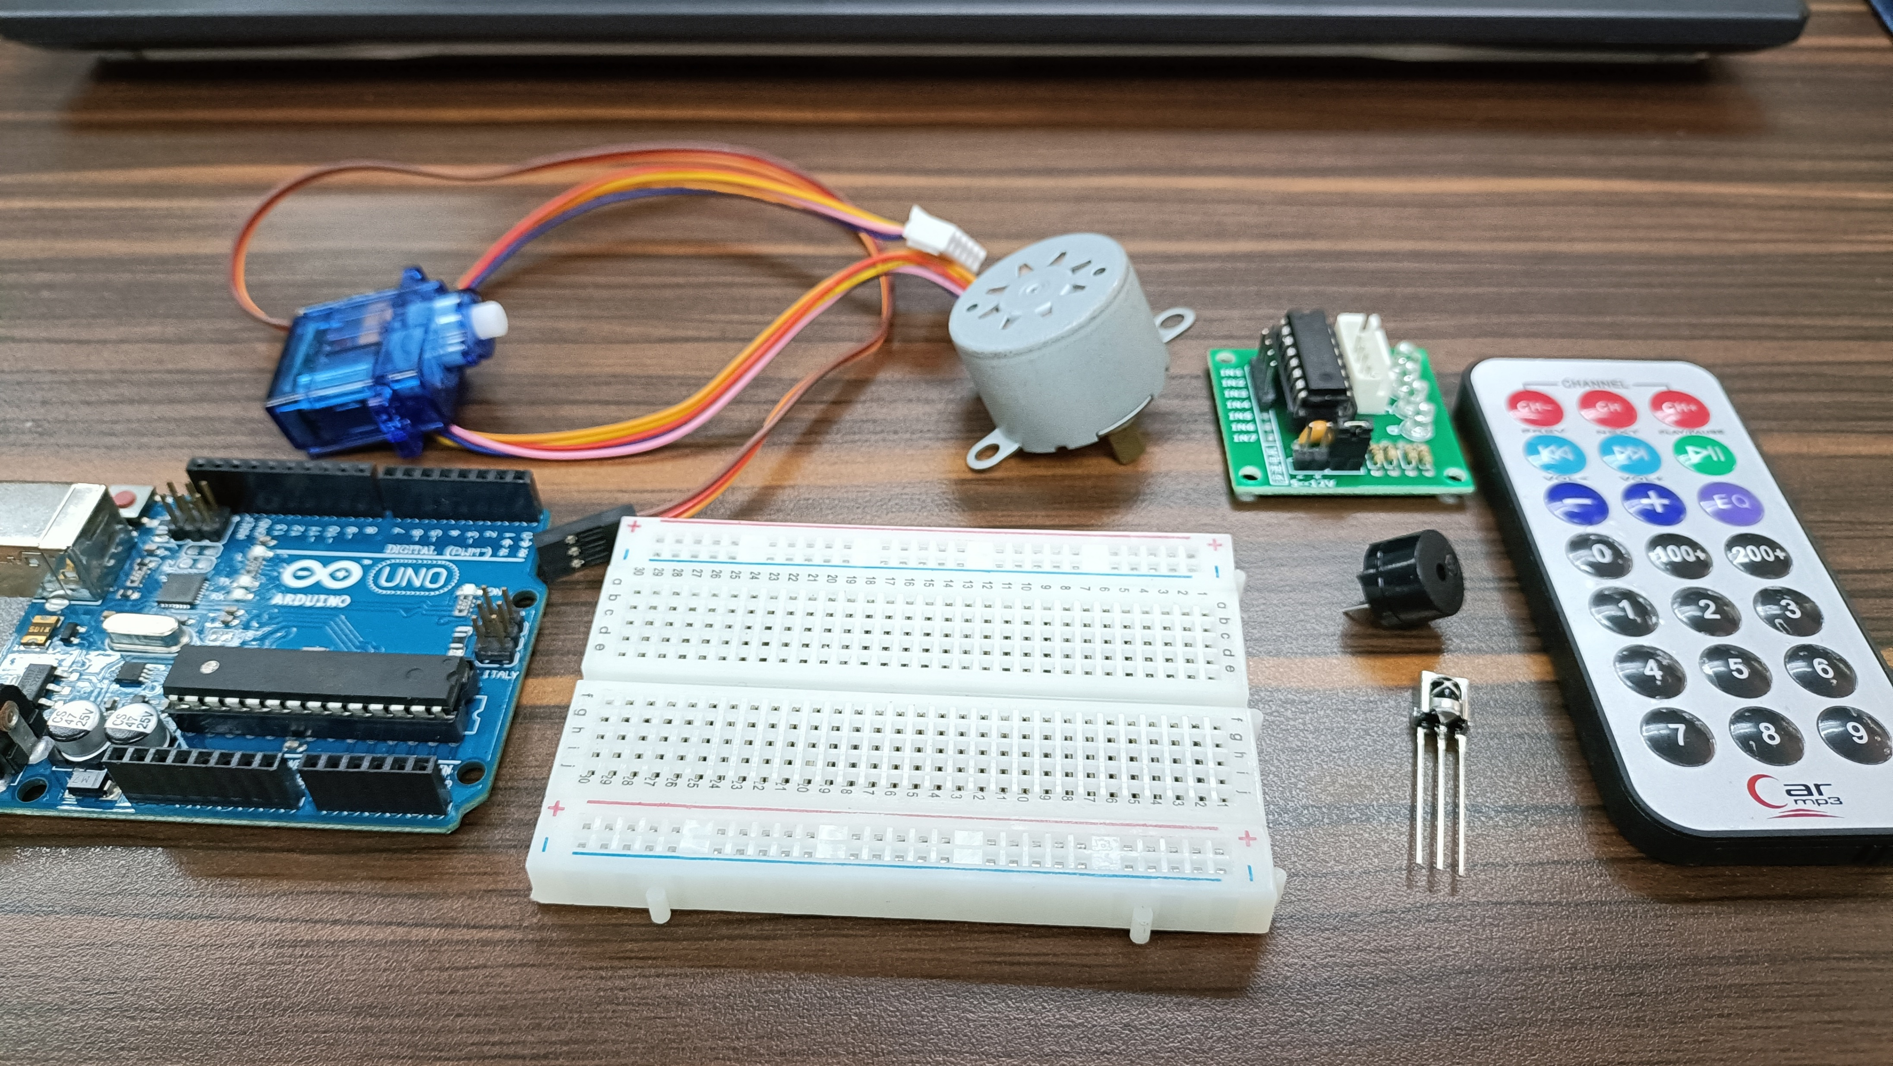
Materials
Hardware
Arduino Uno
Infrared Remote
TSOP1838 IR receiver sensor
28BYJ-48 stepper motor
SG90 servo motor
Passive buzzer
3 LEDs
Notes:
The materials utilized to construct the real-time basketball scoreboard are the Arduino UNO, the 4-digit seven segment display, and 5 switch buttons.

Slide 5
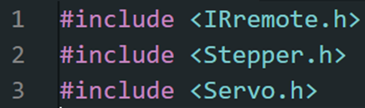
Materials
Software Libraries
IRremote.h
Stepper.h
Servo.h
Notes:
For the external library, only the SevSeg.h was used, which is for the seven segment display.

Slide 6
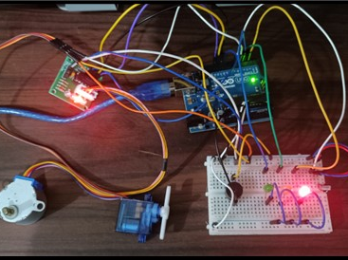
Discussion: Appliance Controller
The IR remote will be used as the controller, wherein it includes the control to every appliance (e.g., stepper motor, servo motor, buzzer, LEDs).
The operations simply turns the appliance ON and OFF with the use of the numbers on the remote and the pause/play button.
Notes:
The first experiment primarily aims to demonstrate how a scoreboard for a basketball game works in real-time. Hence, there should be no delay in adjusting or changing the values of the seven-segment display every time a button was pushed down.
Two functions were used for the adjusting of points since there are two teams to be handled. So, team1() function is used for the adding or subtracting of values for the first two digits of the 4-digit seven segment display. On the other hand, team2() function is used to adjust the values for the rightmost two digits for the seven segment display. Although there are two separate functions, their purpose is the same, and only the digits to be considered are different.

Slide 7
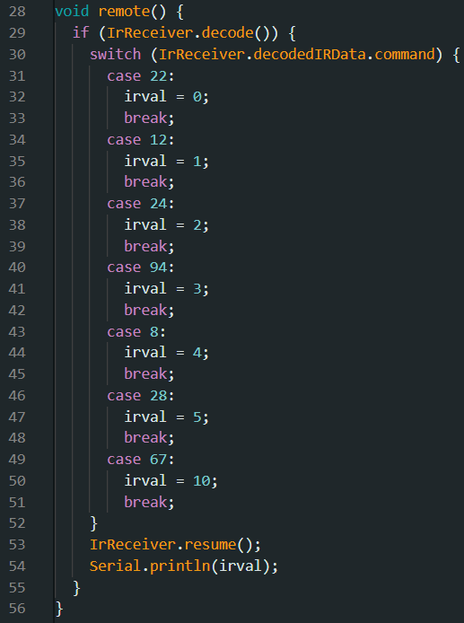
Discussion: Appliance Controller
switch case inside a remote() function was utilized to determine the value of the button pressed in the remote
Button 0 : 22
Button 1: 12
Button 2: 24
Button 3: 94
Button 4 : 8
Button 5 : 28
Pause/Play : 67
Notes:
The first experiment primarily aims to demonstrate how a scoreboard for a basketball game works in real-time. Hence, there should be no delay in adjusting or changing the values of the seven-segment display every time a button was pushed down.
Two functions were used for the adjusting of points since there are two teams to be handled. So, team1() function is used for the adding or subtracting of values for the first two digits of the 4-digit seven segment display. On the other hand, team2() function is used to adjust the values for the rightmost two digits for the seven segment display. Although there are two separate functions, their purpose is the same, and only the digits to be considered are different.

Slide 8
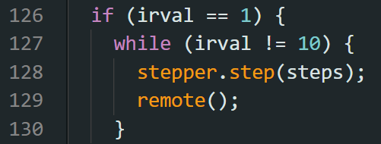
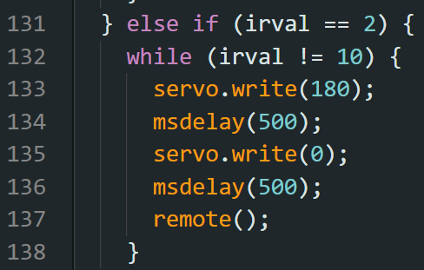
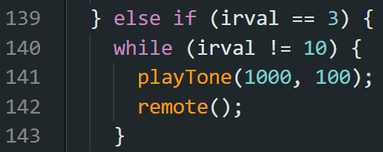
Discussion: Appliance Controller
Button 1 is assigned to the stepper motor : stepper motor continuously rotates
Button 2 is assigned to the servo motor : it writes 180 degrees and 0 degrees every after 500 ms
Button 3 is assigned to the passive buzzer : a separate playTone() function is created
Notes:
The first experiment primarily aims to demonstrate how a scoreboard for a basketball game works in real-time. Hence, there should be no delay in adjusting or changing the values of the seven-segment display every time a button was pushed down.
Two functions were used for the adjusting of points since there are two teams to be handled. So, team1() function is used for the adding or subtracting of values for the first two digits of the 4-digit seven segment display. On the other hand, team2() function is used to adjust the values for the rightmost two digits for the seven segment display. Although there are two separate functions, their purpose is the same, and only the digits to be considered are different.

Slide 9
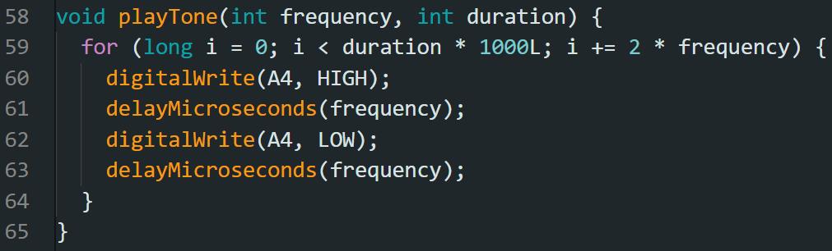
Discussion: Appliance Controller
For passive buzzer, frequency was controlled and duration was specified
Pin is triggered HIGH and LOW in order to turn it ON and OFF, respectively
Notes:
The first experiment primarily aims to demonstrate how a scoreboard for a basketball game works in real-time. Hence, there should be no delay in adjusting or changing the values of the seven-segment display every time a button was pushed down.
Two functions were used for the adjusting of points since there are two teams to be handled. So, team1() function is used for the adding or subtracting of values for the first two digits of the 4-digit seven segment display. On the other hand, team2() function is used to adjust the values for the rightmost two digits for the seven segment display. Although there are two separate functions, their purpose is the same, and only the digits to be considered are different.

Slide 10
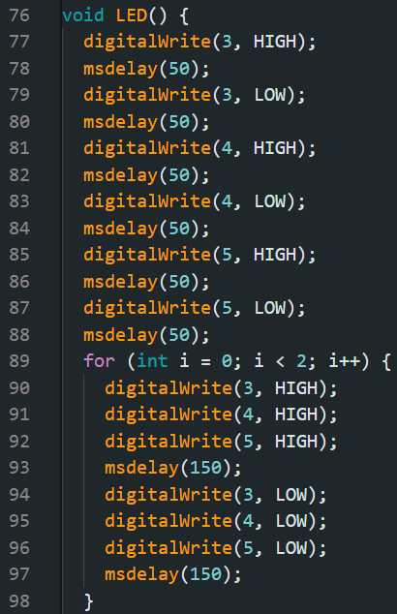
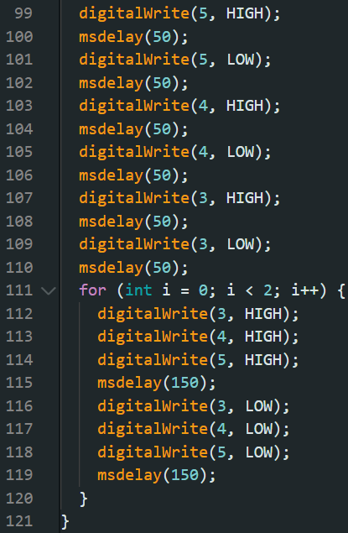
Discussion: Appliance Controller
a pattern of lights turn ON through a process of 1-2-3, ALL-ALL, 3-2-1.
It is assigned to button 4.
Notes:
The first experiment primarily aims to demonstrate how a scoreboard for a basketball game works in real-time. Hence, there should be no delay in adjusting or changing the values of the seven-segment display every time a button was pushed down.
Two functions were used for the adjusting of points since there are two teams to be handled. So, team1() function is used for the adding or subtracting of values for the first two digits of the 4-digit seven segment display. On the other hand, team2() function is used to adjust the values for the rightmost two digits for the seven segment display. Although there are two separate functions, their purpose is the same, and only the digits to be considered are different.

Slide 11
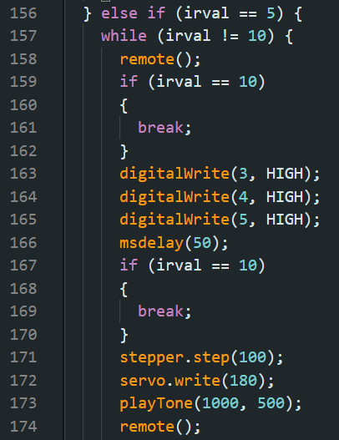
Discussion: Appliance Controller
To activate all, the loop simply contains a repeat of all of the codes utilized for each of the components
Button 5 is assigned to the activation of all the components at once
Notes:
The first experiment primarily aims to demonstrate how a scoreboard for a basketball game works in real-time. Hence, there should be no delay in adjusting or changing the values of the seven-segment display every time a button was pushed down.
Two functions were used for the adjusting of points since there are two teams to be handled. So, team1() function is used for the adding or subtracting of values for the first two digits of the 4-digit seven segment display. On the other hand, team2() function is used to adjust the values for the rightmost two digits for the seven segment display. Although there are two separate functions, their purpose is the same, and only the digits to be considered are different.

Slide 12
Conclusion
The appliance controller works by:
  the use of buttons 1 - 4 for stepper motor, servo motor, buzzer, and LEDs, respectively
  each component can be stopped or reset using the pause/play button
  all of them will activate at once using button 5 as the trigger

Slide 13
Conclusion
The usage of microprocessors, logic circuits, and switching theory, as well as the lessons in CPE160P, was shown utilizing the connections of, motors, buzzers, and output activation, as the second aim was met
The appliance controller was successfully built using the Arduino kit and demonstrated in a basic handshaking by employing various variables, modules, and invoking such functions to develop an embedded system.

